Slide 1
Fee Report System
Guided by : Sakkaravarthi Ramanathan
Subject : 420-ENP-MT OBJECT-ORIENTED PROGRAMMING section 00309
Date : 2018/09/04
Prepared by:
VIJAY TAHELRAMANI (1892593)
JAYESH HARSIYANI(1893343)

Slide 2
OVERVIEW :
Objective
Earlier Problem
Proposed approach
Main advantages of system
Flow of System
Implementation
Algorithm
Screen shot
Conclusion

Slide 3
Objective:
Main objective of project is to develop a fee report system.
Objects
Admin functions
Add accountant
View accountant
Update accountant
Delete accountant
Accountant functions
Add student
View student
Update student
Delete student
Mange Fee report
Student functions
Sign up or login
Check due fees
Pay due fees

Slide 4
The existing manual system used to maintain records of the student on paper, which was an unreliable source:
EARLIER PROBLEM :
Traditional method of maintaining the records was very time consuming.
Earlier method were very costly and error prone.
if the records were wrongly entered then it was very difficult to verify them.
Requires a large amount of manual laborers.

Slide 5
PROPOSED APPROACH
The features that this project include
Main feature of the system includes Login, store the details of accountant and student and also generate the Fees report .
There is a fast retrieval of data and a lot of time saved.
Records can be easily added to the database and relevant records get updated simultaneously.
The records can be easily maintained by anyone.

Slide 6
Main advantages of system
To keep the record of the each student studying in the institution.
Holds the information about the fees of each of the student.
The system helps to manipulate the record of the student without any problem and by easier methods and ways
Anyone with the knowledge of computers, and with authentic password can make changes in the records of the students update them through the system facility.

Slide 7
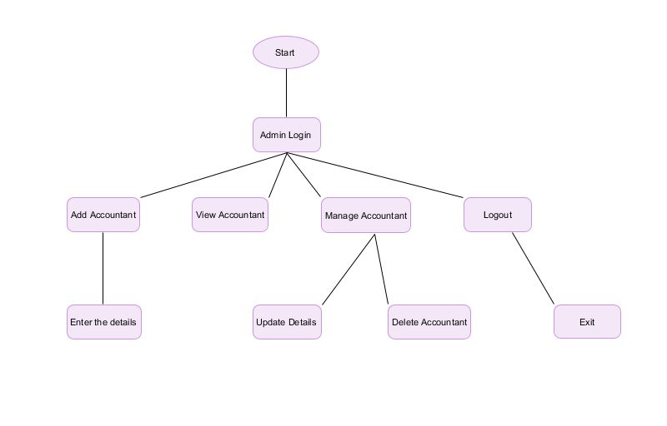
FLOW OF SYSTEM :
Admin

Slide 8
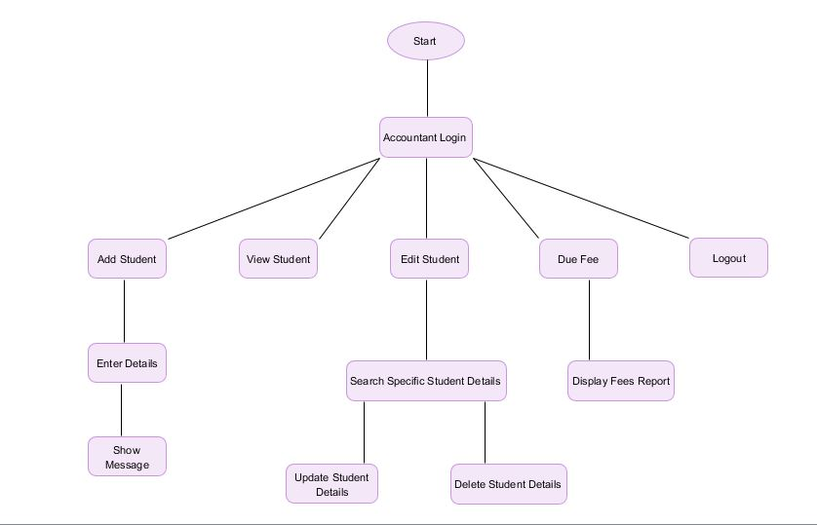
Accountant :

Slide 9
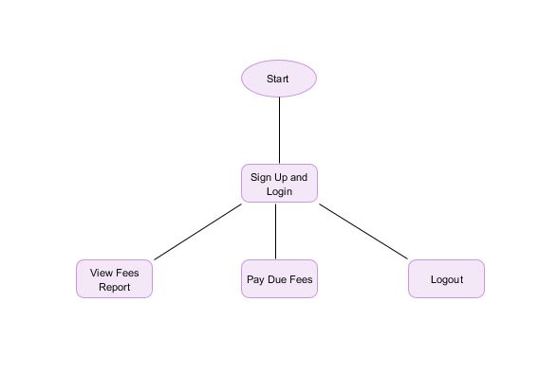
Student

Slide 10


IMPLEMENTATION :

Slide 11
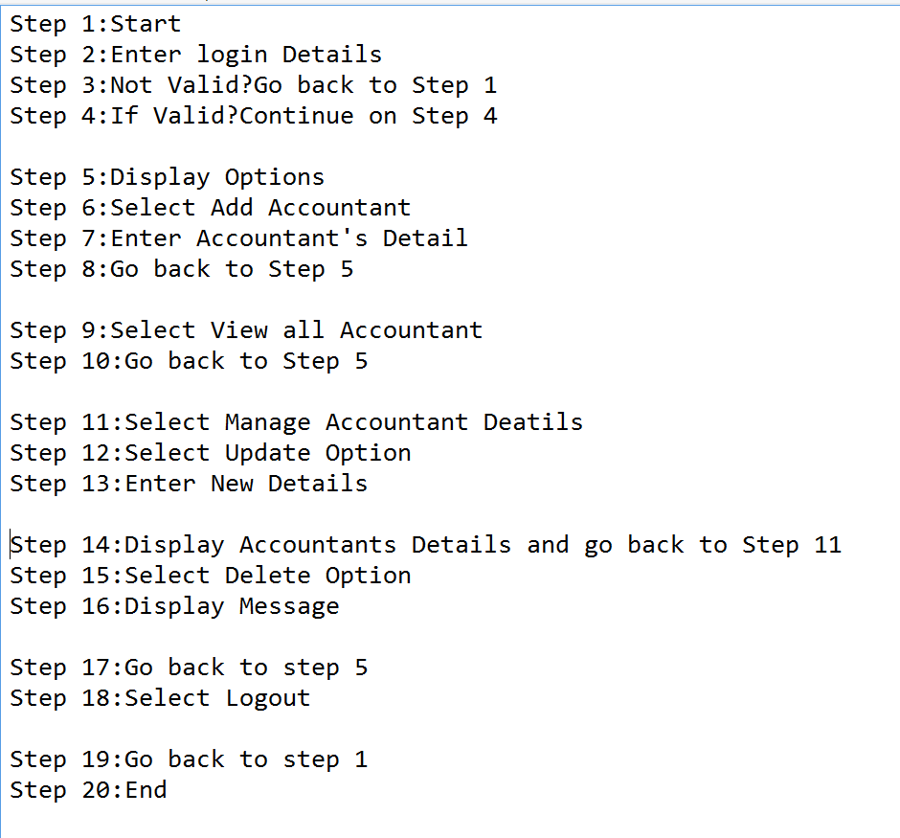
ALGORITHM (Admin) :

Slide 12
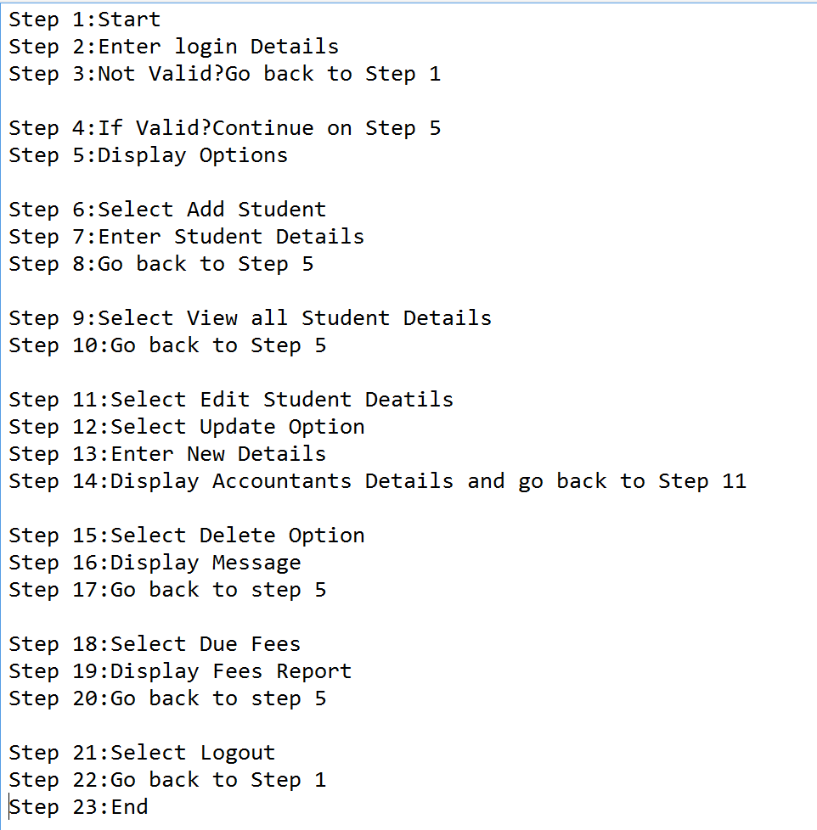
ALGORITHM (ACCOUNTANT) :

Slide 13
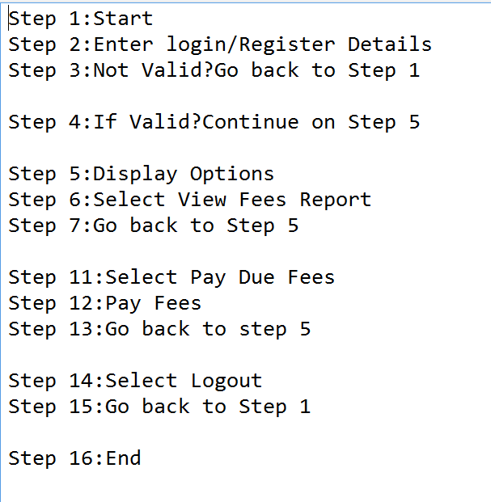
ALGORITHM (STUDENT) :

Slide 14
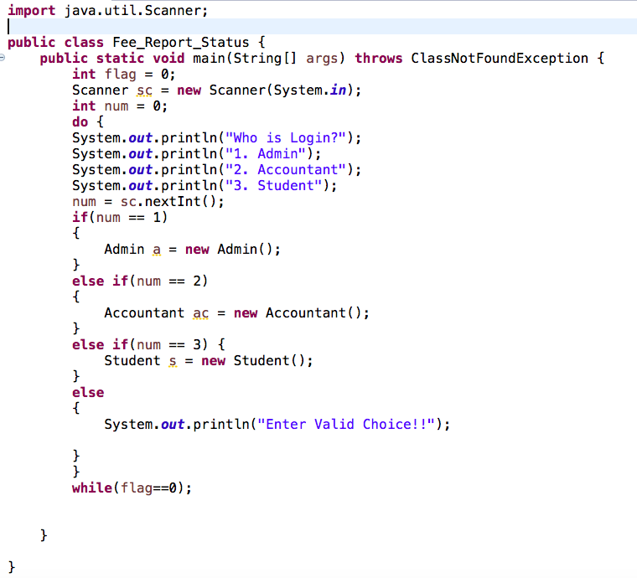
SCREEN SHOT(Main Code) :

Slide 15
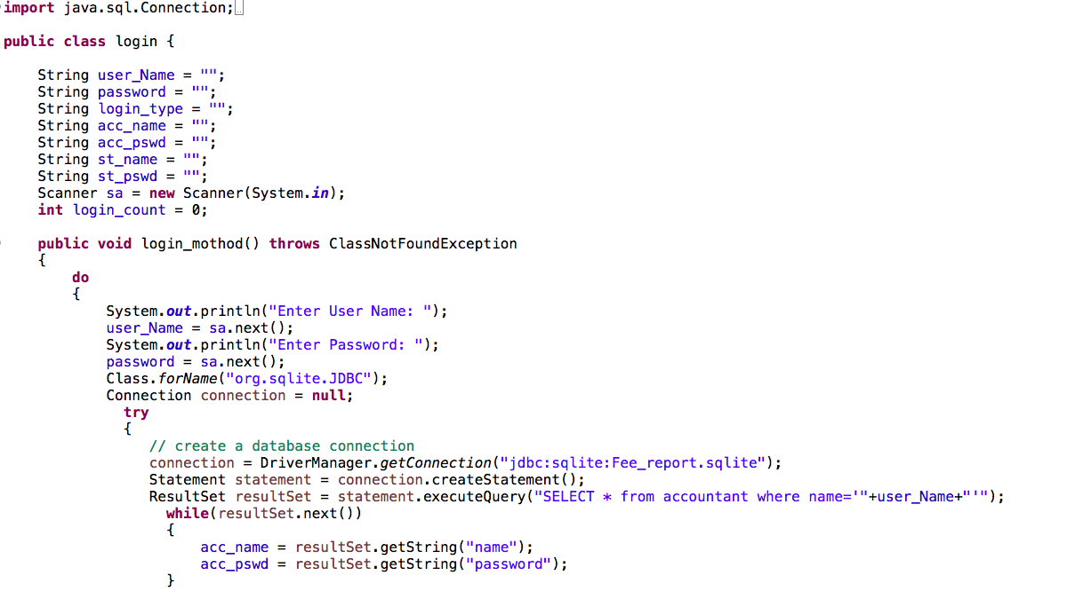
Login:

Slide 16
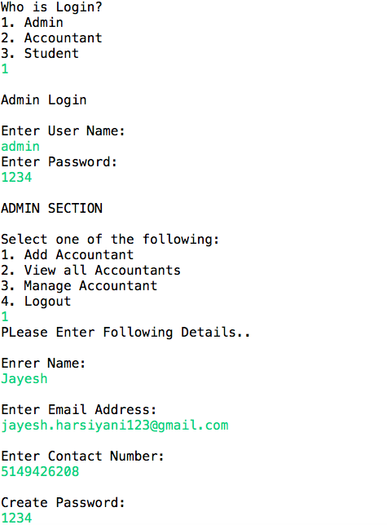
Main Output/Admin Login:

Slide 17
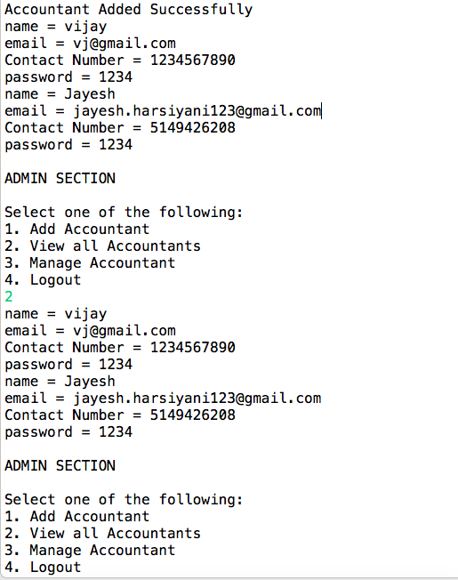
Admin Option:

Slide 18
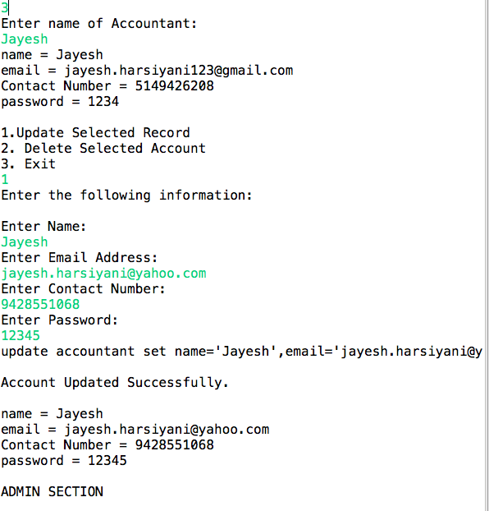
Admin Option:

Slide 19
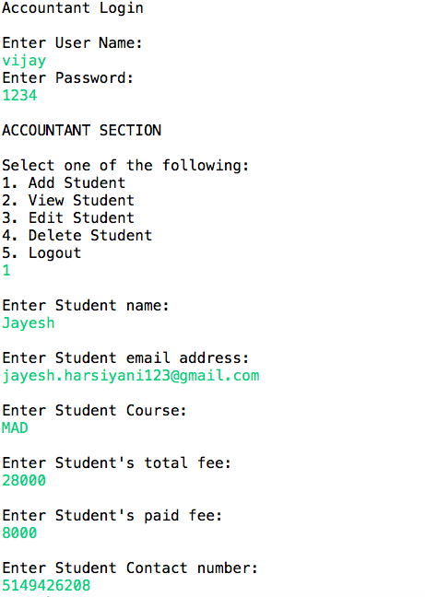
Accountant:

Slide 20
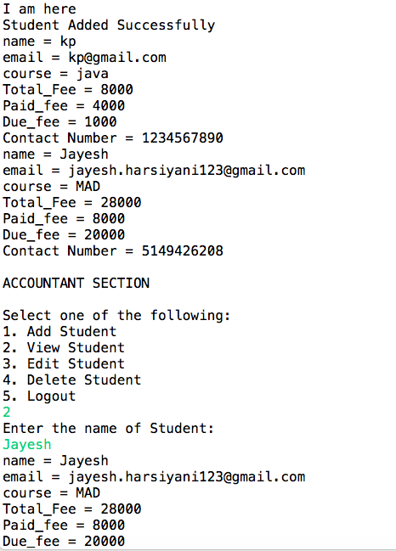
Accountant Option:

Slide 21
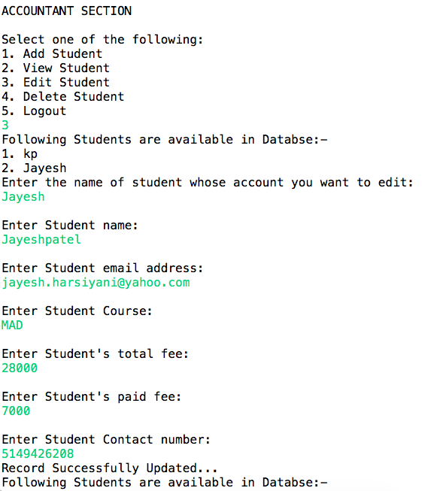
Accountant Option:

Slide 22
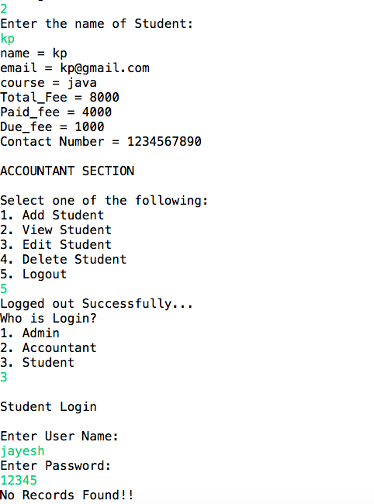
Accountant Option:

Slide 23
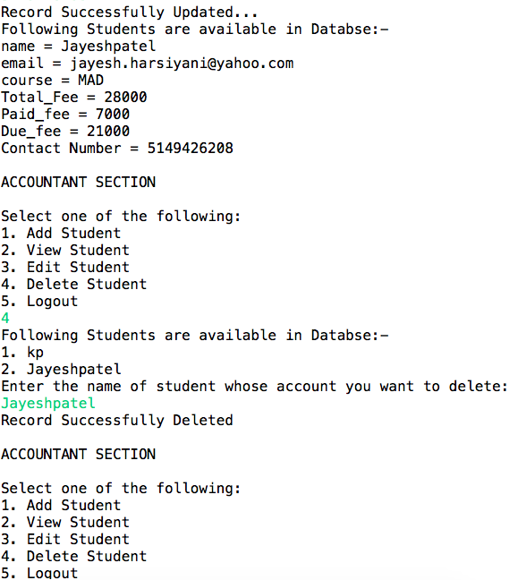
Student Option:

Slide 24
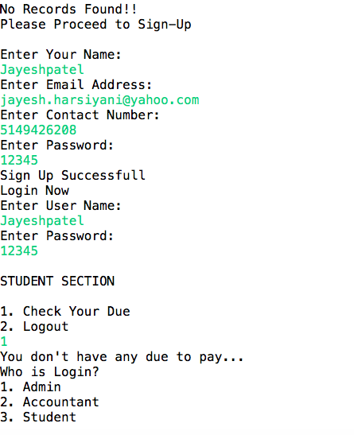
Student Option:

Slide 25
The entire project was developed and deployed in basic oop concepts with the basic sql and database operation Its bug free as per the testing standards Its user friendly
CONCLUSION :

